Slide 1

Overview of ISO 27001:2022
International standard for managing information security, providing a framework to protect data and systems effectively.
IT22339259 – Dewapriya S S

Slide 2
Benefits of ISO 27001:2022 Implementation
Improved Security
Regulatory Compliance
Operational Efficiency
Protects against breaches, attacks, and unauthorized access.
Aligns with data protection laws like GDPR and HIPAA.
Streamlines risk management and incident response.

Slide 3
Key Changes in ISO 27001:2022
1
Updated Control Set
Addresses modern security challenges like cloud and mobile.
2
Risk-Based Thinking
Tailored approach to manage organizational risks.
3
Alignment with ISO 31000
Integrates risk management practices.

Slide 4

Structure of ISO 27001:2022
Context of the Organization
Understanding internal and external factors.
Leadership
Commitment and defined roles.
Planning
Risk assessments and objectives.
Performance Evaluation
Monitoring, measuring, and reviewing the ISMS.

Slide 5
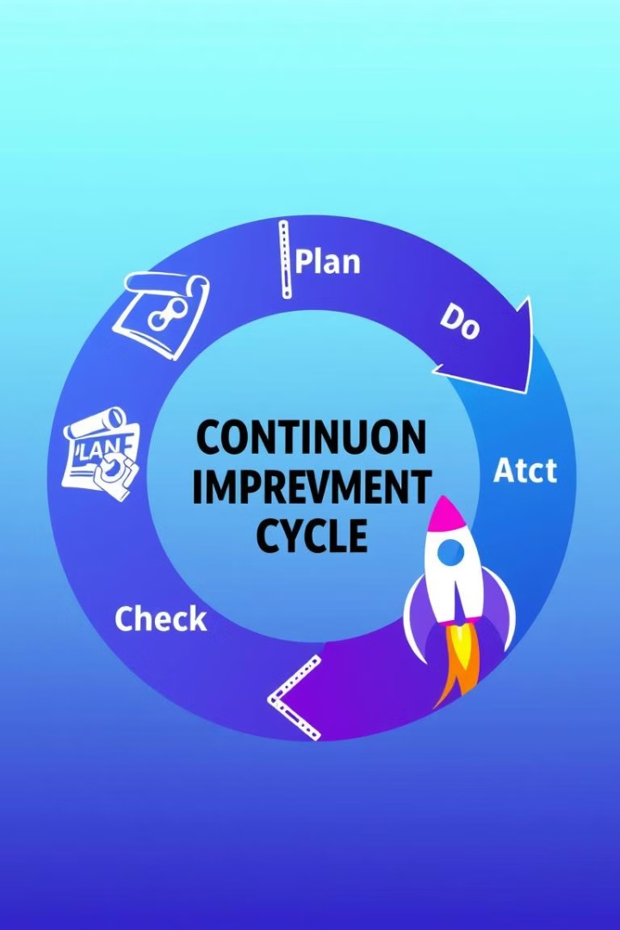
The PDCA Model
1
Plan
Establish ISMS policies and processes.
2
Do
Implement and operate the ISMS controls.
3
Check
Monitor, measure, and review ISMS performance.
4
Act
Take corrective actions for continual improvement.

Slide 6
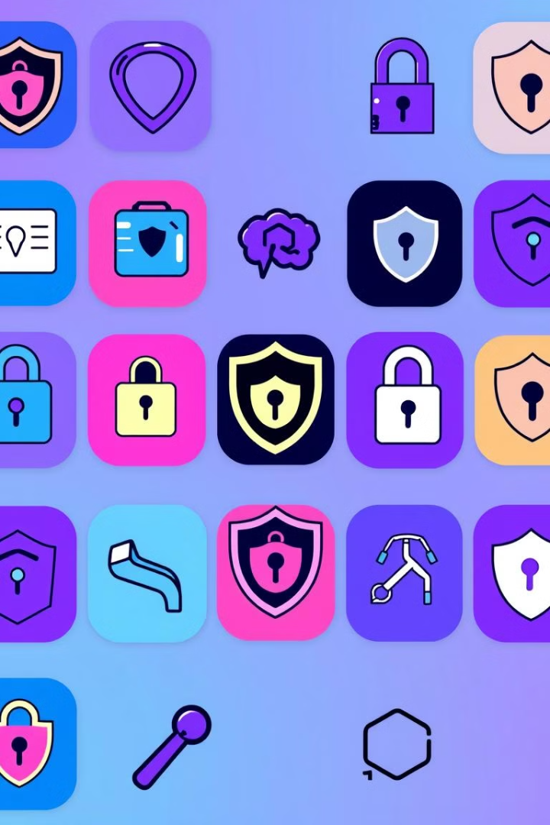




Annex A Controls
Organizational
Policies, procedures, and governance.
People
Roles, responsibilities, and awareness.
Physical
Physical security and environmental controls.
Technological
Technical security controls and solutions.

Slide 7
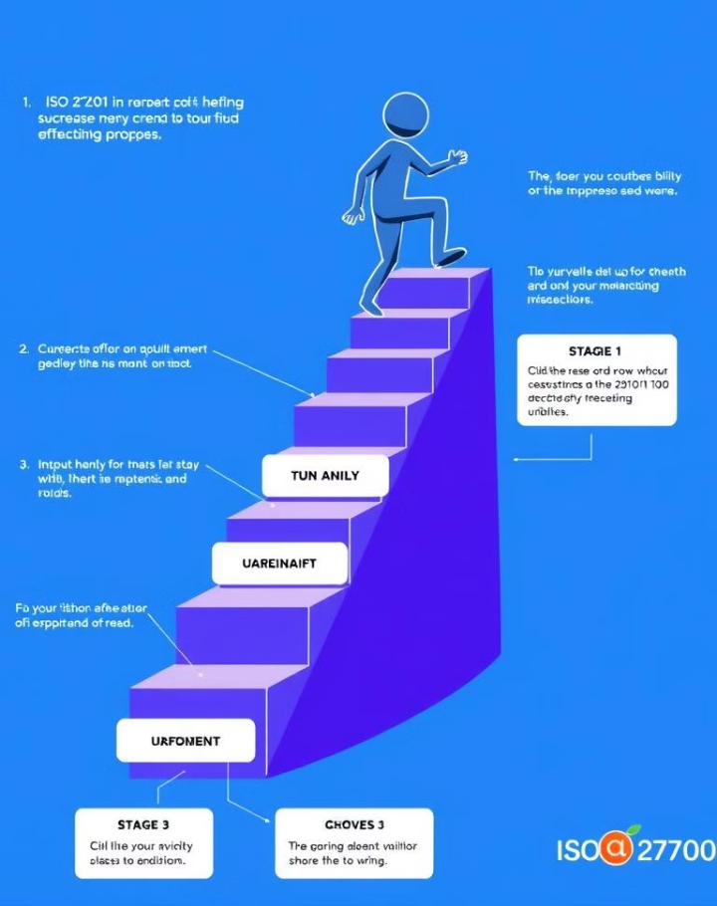



Steps to Implement ISO 27001:2022
Define Scope
Identify ISMS boundaries.
Conduct Risk Assessment
Identify and assess information security risks.
Implement Controls
Based on risk assessment and Annex A.

Slide 8

ISO 27001:2022 Certification Process
Preparation
Gap analysis and ISMS readiness.
Stage 1 Audit
Review of ISMS documentation and readiness.
Stage 2 Audit
Assessment of ISMS implementation and controls.
Certification Decision
Issuance of certification if compliant.
Ongoing Surveillance
Regular audits to ensure continual compliance.

Slide 9
Challenges in ISO 27001 Implementation
Resource Allocation
Dedicated time, budget, and skilled personnel.
Change Management
Overcoming resistance to new security processes.
Ongoing Maintenance
Continuous monitoring, auditing, and improvement.

Slide 10
Thank You
1
Key Takeaways
ISO 27001 provides a comprehensive security framework.
2
Call to Action
Start gap analysis and define implementation scope.

